Slide 1
SPATIAL FILTERING

Slide 2
NEIGHBOURHOOD OPERATIONS
simply operate on a larger neighbourhood of pixels than point operations
Neighbourhoods → mostly a rectangle around a central pixel
Any size rectangle and any shape filter are possible
Origin
x
(x, y)
Neighbourhood
y
Image f (x, y)

Slide 3
NEIGHBOURHOOD OPERATIONS
Some simple neighbourhood operations :
Min: Set the pixel value to the minimum in the neighbourhood
Max: Set the pixel value to the maximum in the neighbourhood
Median: The median value of a set of numbers is the midpoint value in that set (e.g. from the set [1, 7, 15, 18, 24] 15 is the median). Sometimes the median works better than the average

Slide 4
THE SPATIAL FILTERING PROCESS
Origin
x
a
b
c
r
s
t
d
e
f
u
v
w
g
h
i
x
y
z
Original Image Pixels
Filter
e_{processed} = v*e + r*a + s*b + t*c + u*d + w*f + x*g + y*h + z*i
y
Image f (x, y)
repeat for every pixel in the original image to generate the filtered image

Slide 5
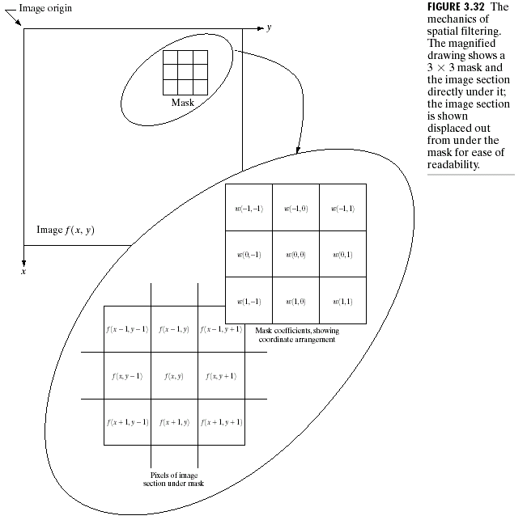
THE SPATIAL FILTERING

Slide 6
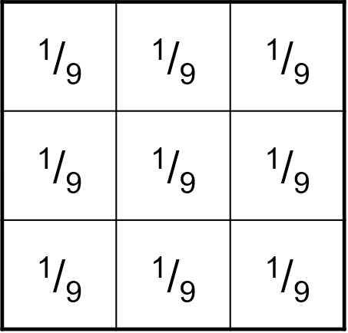
THE SPATIAL FILTERING - SMOOTHING
One of the simplest spatial filtering operations we can perform is a smoothing operation
Simply average all of the pixels in a neighbourhood around a central value
Especially useful in removing noise from images
Also useful for highlighting details
Simple averaging filter

Slide 7
THE SPATIAL FILTERING - SMOOTHING
Origin
104
100
108
¹/₉
¹/₉
¹/₉
99
106
98
*
¹/₉
¹/₉
¹/₉
95
90
85
¹/₉
¹/₉
¹/₉
Original Image Pixels
Filter
¹/₉
¹/₉
¹/₉
¹/₉
¹/₉
¹/₉
¹/₉
¹/₉
¹/₉
e = ¹/₉*106 + ¹/₉*104 + ¹/₉*100 + ¹/₉*108 + ¹/₉*99 + ¹/₉*98 + ¹/₉*95 + ¹/₉*90 + ¹/₉*85
= 98.3333
Image f (x, y)

Slide 8
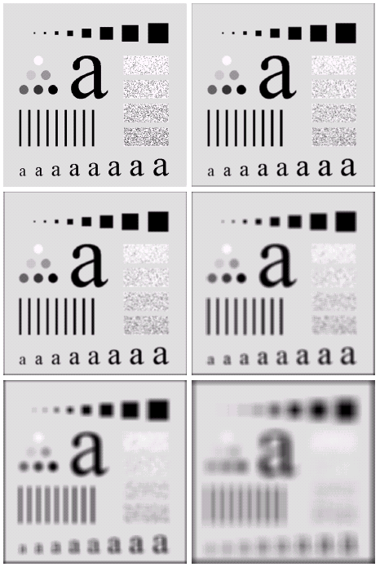
Smoothing Example
The image at the top left is an original image of size 500*500 pixels
The subsequent images show the image after filtering with an averaging filter of increasing sizes
3, 5, 9, 15 and 35
Notice how detail begins to disappear

Slide 9
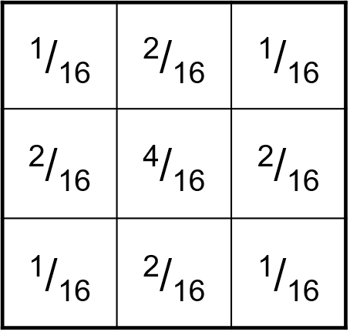
Weighted Smoothing Filters
More effective smoothing filters →by allowing different pixels in the neighbourhood different weights in the averaging function
Pixels closer to the central pixel are more important
Often referred to as a weighted averaging
Distance =1 px
Weighted averaging filter
Distance =1.4 px

Slide 10
Weighted Smoothing Filters
More effective smoothing filters →by allowing different pixels in the neighbourhood different weights in the averaging function
Pixels closer to the central pixel are more important
Often referred to as a weighted averaging
Distance =1 px
Weighted averaging filter
Distance =1.4 px

Slide 11
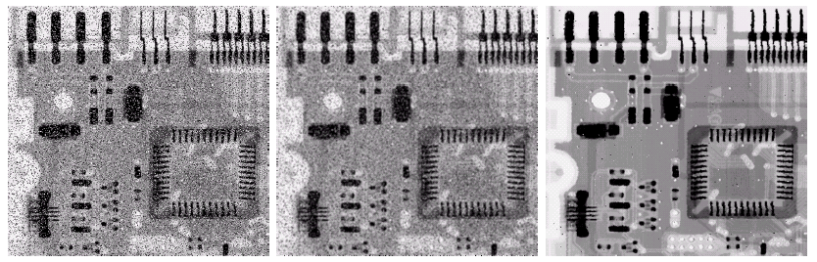
Weighted Smoothing Filters
Filtering is often used to remove noise from images
Sometimes a median filter works better than an averaging filter
Original Image With Noise
Image After Averaging Filter
Image After Median Filter
Still noisy

Slide 12
Filtering At The EDGES
At the edges of an image we are missing pixels to form a neighbourhood
Origin
x
e
e
?
e
e
e
e
e
y
Image f (x, y)

Slide 13
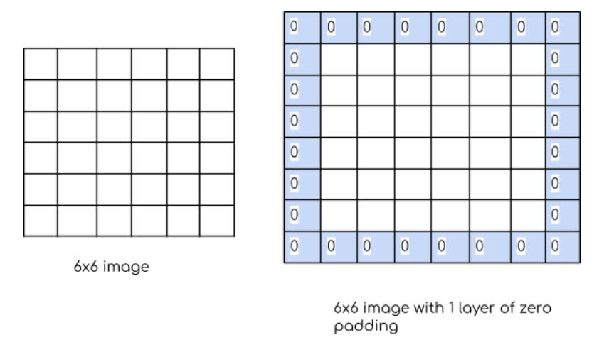
Filtering At The EDGES
Pad the image
Typically with either all white or all black pixels (ZERO PADDING)

Slide 14
SPATIAL FILTERS - SHARPENING
Sharpening spatial filters → to highlight fine detail
Remove blurring from images
Highlight edges
Sharpening filters are based on spatial differentiation

Slide 15
SPATIAL FILTERS - SHARPENING
Differentiation measures the rate of change of a function
It’s just the difference between subsequent values and measures the rate of change of the function
The formula for the 1st order derivative of a function is as follows:

Slide 16
SPATIAL FILTERS - SHARPENING
The formula for the 2nd order derivative of a function is as follows:
Simply takes into account the values both before and after the current value

Slide 17
SPATIAL FILTERS - SHARPENING
The 2nd order derivative is more useful for image enhancement than the 1st derivative
Stronger response to fine detail
Simpler implementation

Slide 18
SPATIAL FILTERS – SHARPENING-LAPLACIAN
The Laplacian is defined as follows:
where the partial 2nd order derivative in the x direction is defined as follows:
and in the y direction as follows:

Slide 19
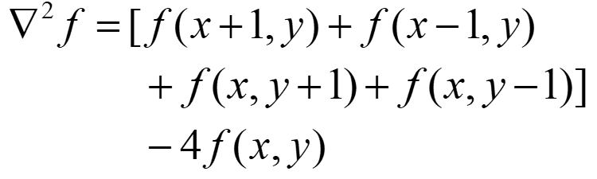
SPATIAL FILTERS – SHARPENING-LAPLACIAN
So, the Laplacian can be given as follows:
We can easily build a filter based on this:
? | ? | ?
? | ? | ?
? | ? | ?

Slide 20
SPATIAL FILTERS – SHARPENING-LAPLACIAN
So, the Laplacian can be given as follows:
We can easily build a filter based on this:
0
1
0
f(x+1,y-1)
1
-4
1
f(x+1,y)
0
1
0

Slide 21
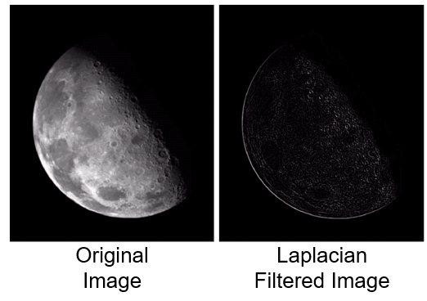
SPATIAL FILTERS – SHARPENING-LAPLACIAN
Applying the Laplacian → we get a new image that highlights edges and other discontinuities

Slide 22
SPATIAL FILTERS – SHARPENING-LAPLACIAN
The result of a Laplacian filtering is not an enhanced image
Subtract the Laplacian result from the original image
to obtain a sharpened enhanced image

Slide 23
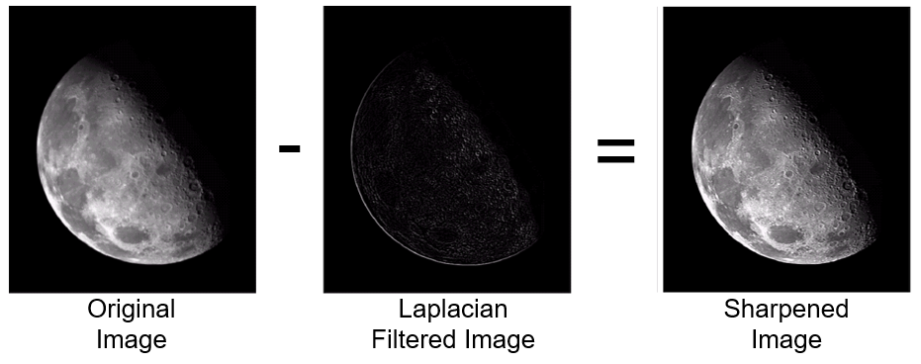
SPATIAL FILTERS – SHARPENING-LAPLACIAN
EDGES AND DETAILS ARE MUCH MORE OBVIOUS!

Slide 24
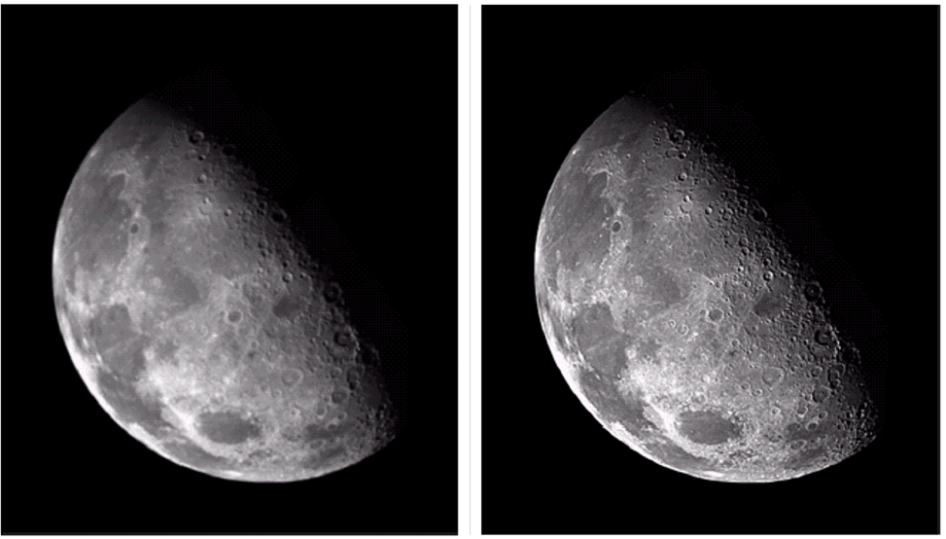
SPATIAL FILTERS – SHARPENING-LAPLACIAN
ORIGINAL IMAGE (blurry)
SHARPENED IMAGE BY LAPLACIAN
EDGES AND DETAILS ARE MUCH MORE OBVIOUS!

Slide 25
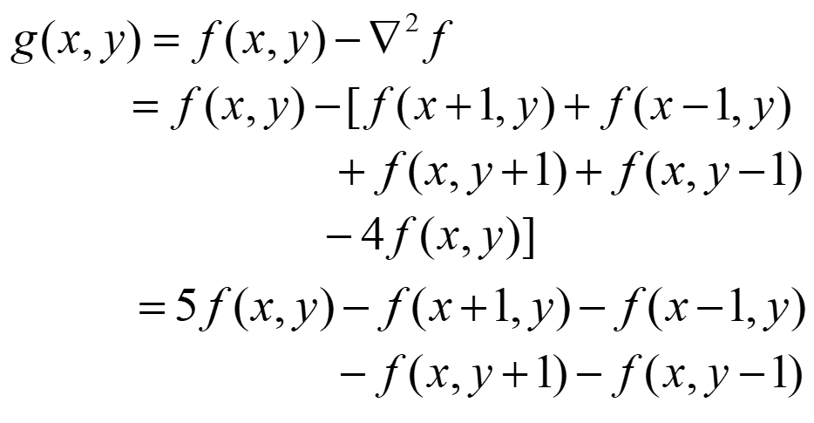
SPATIAL FILTERS – SHARPENING-LAPLACIAN
The entire enhancement → a single filtering operation

Slide 26
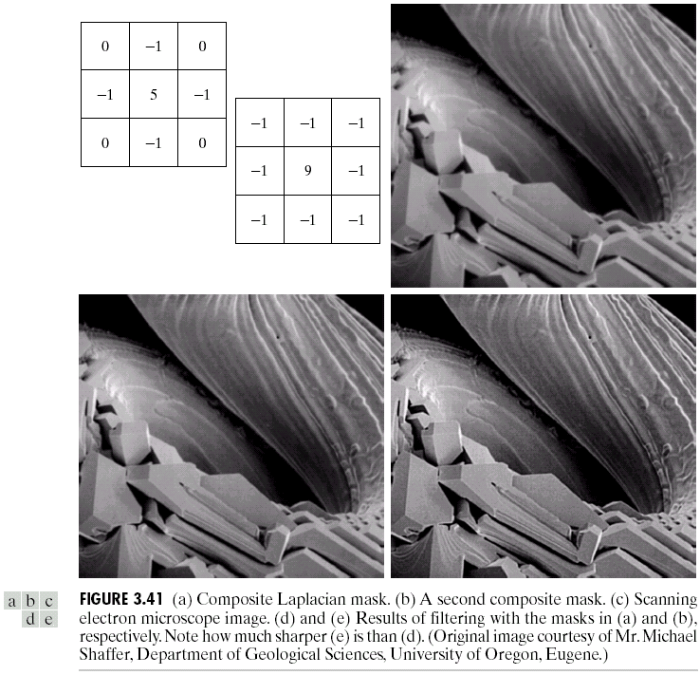
SPATIAL FILTERS – SHARPENING-LAPLACIAN
The entire enhancement → a single filtering operation
0
-1
0
-1
5
-1
0
-1
0
A new filter that sharpens the image in one step

Slide 27

1st ORDER DERIVATE OPERATORS - SOBEL
The positive values (+1 and +2) on the right side give more weight to pixels with higher intensity, emphasizing transitions from dark to bright as we move horizontally.
Similarly, the negative values (-1 and -2) on the left side emphasize transitions from bright to dark.
-1
-2
-1
-1
0
1
0
0
0
-2
0
2
1
2
1
-1
0
1
EDGE DETECTION!
They are sensitive to noise in the image, which can lead to false edge detection.

Slide 28
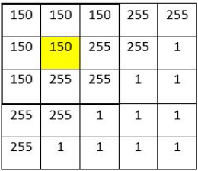
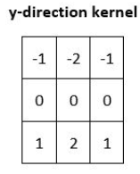
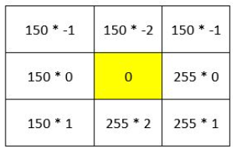
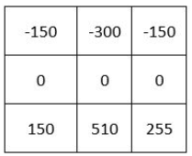
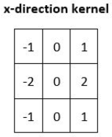
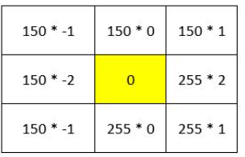
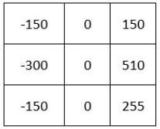
1st ORDER DERIVATE OPERATORS - SOBEL
G_{y} for the pixel in row 2, column 2 is 315.
G_{x} for the pixel in row 2, column 2 is 315.

Slide 29
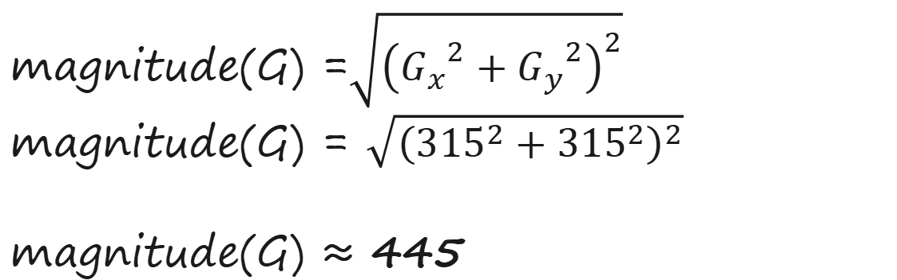
1st ORDER DERIVATE OPERATORS - SOBEL
magnitude(G) =$\sqrt{{\left({G_{x}}^{2}+{G_{y}}^{2}\right)}^{2}}$
magnitude(G) = $\sqrt{{\left({315}^{2}+{315}^{2}\right)}^{2}}$
magnitude(G) ≈ 445

Slide 30
WHAT IF A PIXEL VALUE EXCEEDS 255?
445 | 0 | 255
200 | 0 | 0
210 | 155 | 255
=[(445-0)/(445-0)](255-0) + 0 = 255
255 | 0 | 146
115 | 0 | 0
120 | 89 | 146

